Slide 1
SAUG March Meetup:
Identity in Azure

Slide 2

Agenda
Time | Item
20:00-20:10 | Introductions JT/RL - SAUG March 2020 Meetup David Murphy and Acora
20:10-20:40 | Azure Identity - Part 1 What is an Identity, and what is the Azure AD? Azure AD Sync with On-Premise AD Passwordless Authentication Azure AD B2B & B2C
20:40-20:50 | Break & Refuel
20:50-20:55 | Any key questions from Part 1
20:55-21:25 | Azure Identity - Part 2 Azure AD Single Sign-On Options Using Azure AD To Secure Your Identities Further (MFA, Identity Protection, Conditional Access) Azure AD Competitors Comparison
21:25-21:30 | Any key questions from Part 2 & Round-off

Slide 3

Introduction
David Murphy
Enterprise Architect
Been an Acoran for around 13 years (14 in September…)
Service Desk, Systems Engineering, Low Level Design, High Level Design “Architecture”
Technical Background
MS Stack (First certs were for MCSA 2003)
Bit of SQL
Quite a lot of Citrix
Fair amount of NetApp and vSphere
More Hyper-V than is healthy…
Most recently, Azure and O365
Primary responsibilities now are running presales function and working in vCTO Office

Slide 4
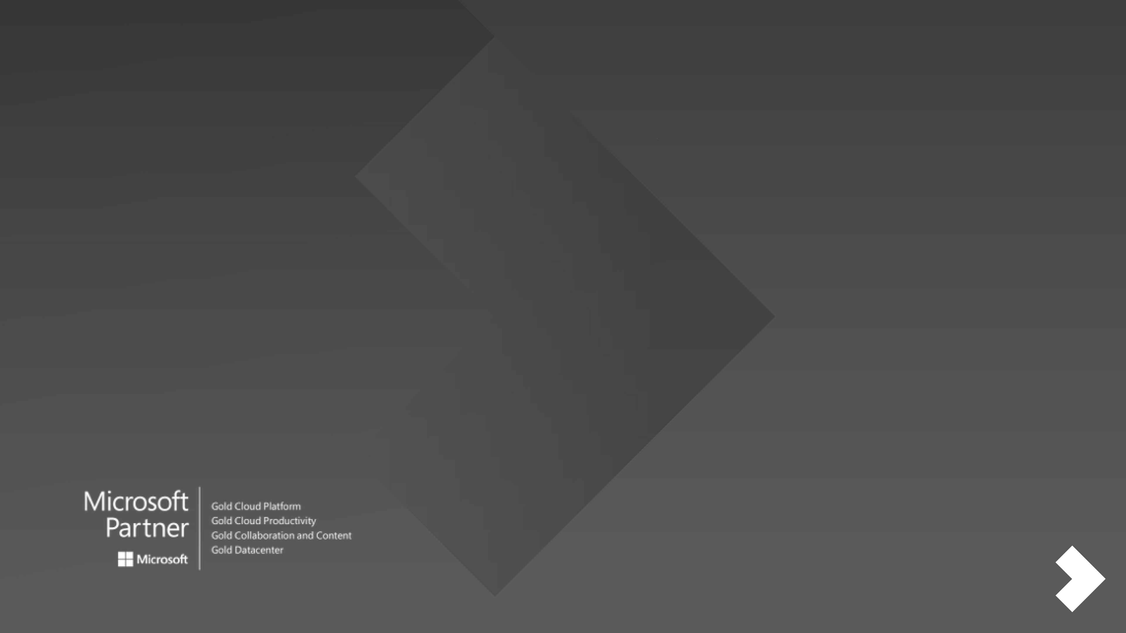





About Acora
We are a UK based, award-winning, IT services and technology company with over 25 years’ experience. We provide a range of IT support and Microsoft-centric, business software and cloud solutions to help mid-market organisations modernise their IT so they can compete and win in the digital economy. More than 260 clients trust us to take responsibility for part, or all, of their IT
from solution design to support.
Managed
Services
Business Software
Workspace Services
Cloud
Services
Security
Services

Slide 5
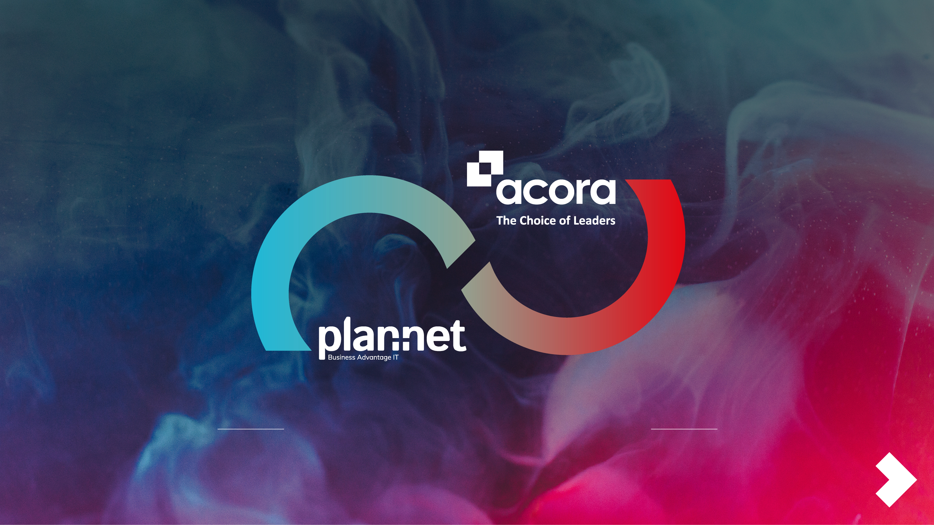
Acora Holdings
Plan-Net has been transforming IT for legal, financial & publishing organisations for 30 years. Keeping its customers up to date with the evolving technology that drives their businesses
forward.
195 people
2 offices
120 customers
£10m revenue
Acora provides a range of IT support and Microsoft-centric, business software and cloud solutions to drive mid-market organisations to modernise their IT so they can compete and win in the digital economy.
145 people
2 offices
140 customers
£20m revenue
340
4
260
30m
people
offices
customers
revenue

Slide 6
What is an Identity?

Slide 7


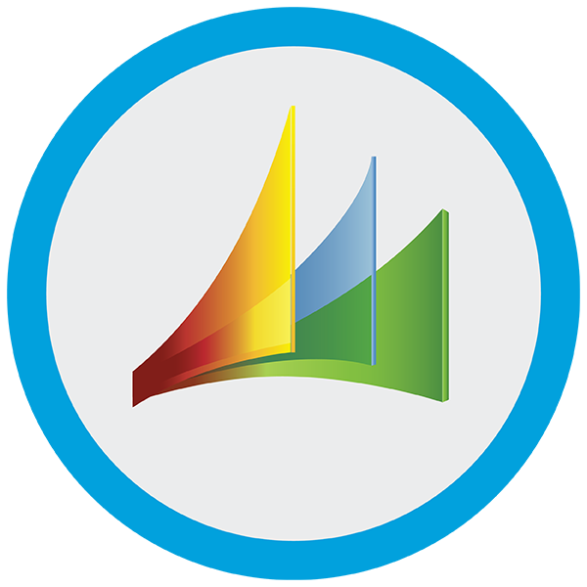
Before
Identity: Who are you?
Identity has evolved
Your LOB application login - Username and Password? Or even the badge you wore!
Swipe card – door entry?
Active Directory Account name?
Email address?
LOB 1
Then
LOB 1
Who you are.
Notes:
Rather than jump in, what is Identity?
start - punch cards - ID card
Mainframe and Timeshare - distributed - terminal/username
Distributed - individual units - moved the ID to the edge
Same time... centralised resources
Domain, then AD - shifted. auth to ID.
Also ID of the device - made security interesting dealing with kiosk workers, generic
Very interesting time for about 20 yrs - ID in App, vs ID in central. many a SQL argument!
A lot of people are today.
Next step - Cloud ID. Same interesting battle, for something of a 10 year overlap.

Slide 8



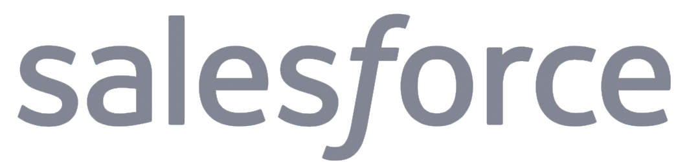
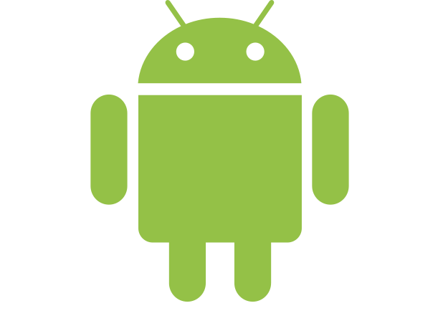


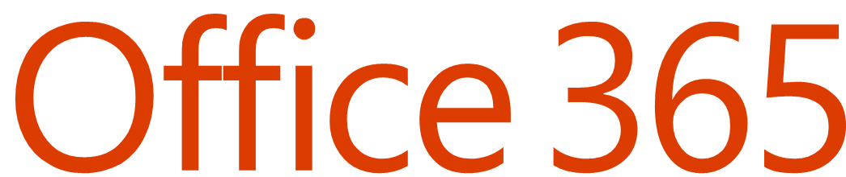
Now/Next…
Identity
Is the new control plane
On-premises /
Private cloud
Notes:
As organizations and their employees are moving to the cloud, the security strategy needs to start with a strong protected single identity at the center of the business. AS we talk to customers who’re moving to the cloud, we realize that they are still concerned about network security in their journey to the cloud. The reality is that as you move the cloud, the identity becomes your control plane, it is the new perimeter. As you can see the confines of the enterprise is no longer and can no longer be the perimeter of your organization. Having a strong identity and access strategy is critical, I want to say crucial for balancing security and productivity in the organization and for being the first line of defense.
So Identity is the new control plane, it safeguards your core assets on-prem and in the cloud. But we also know that most breaches can be traced back to compromised credentials, remember the stat I mentioned about the credentials under attack! Let me show you how risk based conditional access helps you identify at risk credentials, and take the appropriate steps to avoid breach or data exfiltration, while providing a good experience for IT and users – internal and external!
© Microsoft Corporation. All rights reserved. MICROSOFT MAKES NO WARRANTIES, EXPRESS, IMPLIED OR STATUTORY, AS TO THE INFORMATION IN THIS PRESENTATION.
3/25/2020 10:14 PM
8

Slide 9
What is the Azure AD?

Slide 10

Azure AD…
What is it?
A truly cloud-based Identity Solution
One big multi-tenanted platform
Highly-resilient SaaS solution
What isn’t it?
Active Directory in the Cloud
My Identity Platform
Office 365 authentication (!?)
Azure AD
User Principle Name
Registered Device
InTune Configuration
…
…
…
Traditional AD
Active Directory GUID
Computer Account
Group Policy
FSMO Roles
Schema Updates
AD Forest
Notes:
Run through…
AD in the Cloud… no, it isn’t.
Active Directory Domain Services… no it isn’t. VERY serious difference… cover in the next slide
Office 365 Authentication… GENUINELY heard someone call it that the other day!!

Slide 11
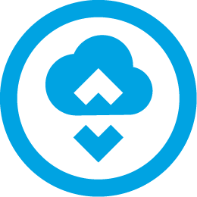
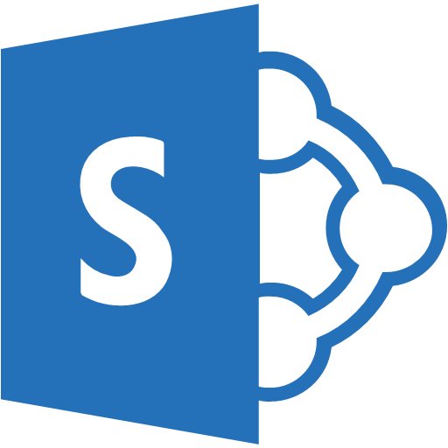
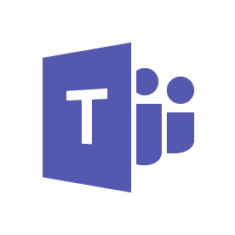
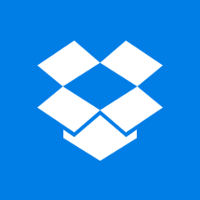


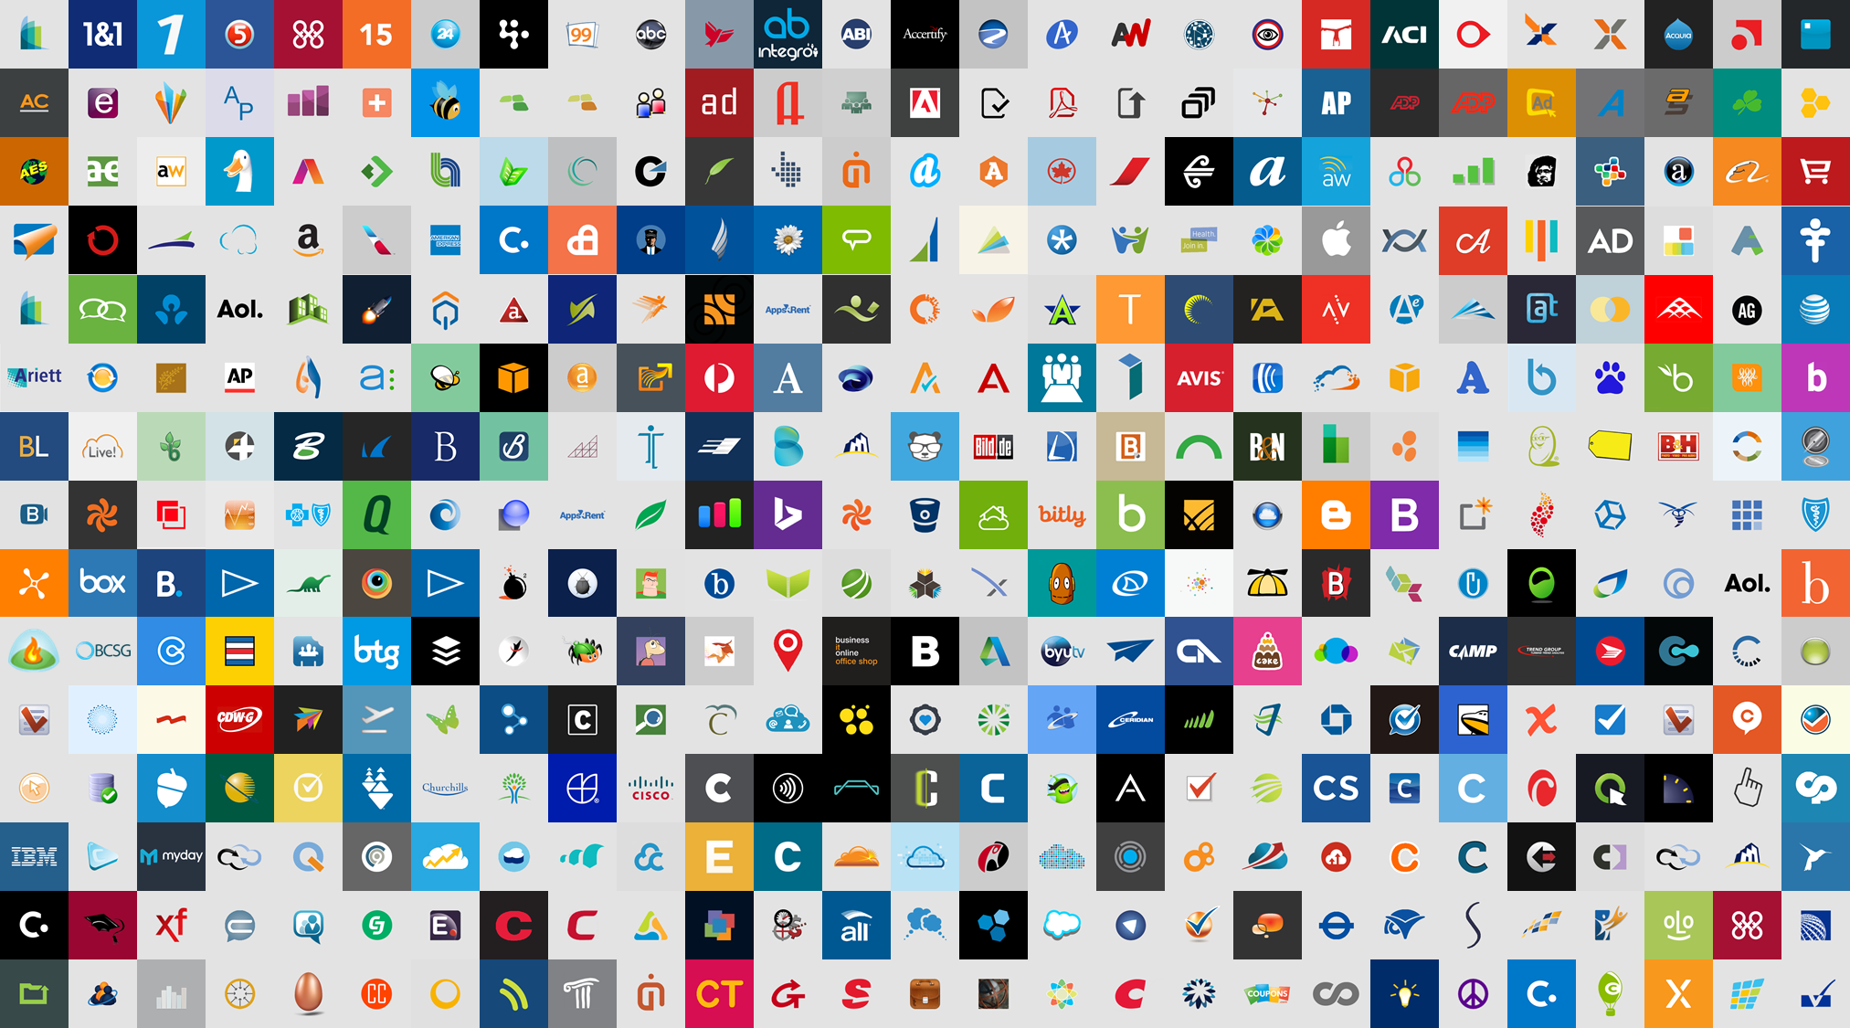

https://docs.microsoft.com/en-us/azure/active-directory/hybrid/plan-connect-topologies
Azure AD Connect Sync
Assign B2B users access to any app or service your organization owns
Other organizations
SharePoint Online & Office 365 apps
Add B2B users with accounts in other Azure AD organizations
Microsoft Azure
Active Directory
Matches the identity objects that exist in the on-premise directory service with those that exist in the Azure AD. Both User and Computer objects (hybrid AD Join).
On- premises

Slide 12
What is Passwordless Authentication?

Slide 13

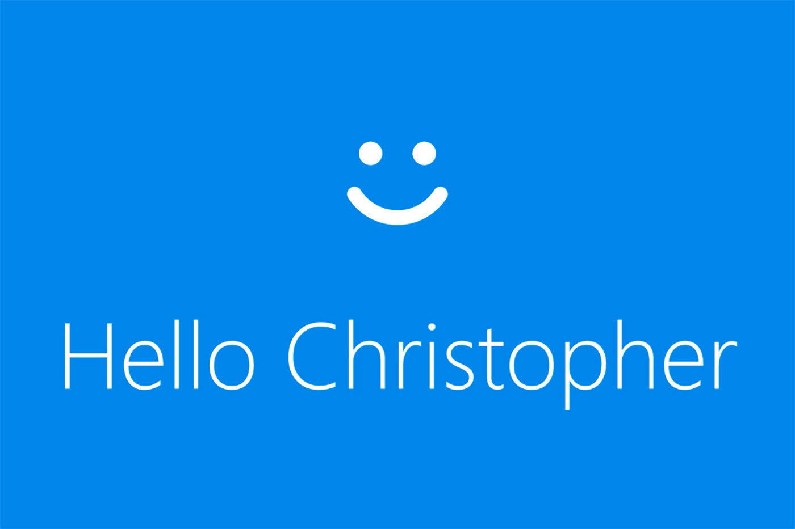
Passwordless Authentication
Traditional – Username and Password
Next – 2-Factor Authentication – “something you have and something you know”
Biometric – e.g. Windows Hello, unlocks the locally cached credentials to be used
Common factor is that under the hood, the credentials are still passed in TCP stream. And at some point, you typed your password on that system.
None of these is passwordless authentication.
https://www.acora.com/2020/01/20/raiders-of-the-lost-password/
Notes:
Probably the coolest authentication I’ve seen in a while… I wrote a blog about it a while ago.

Slide 14
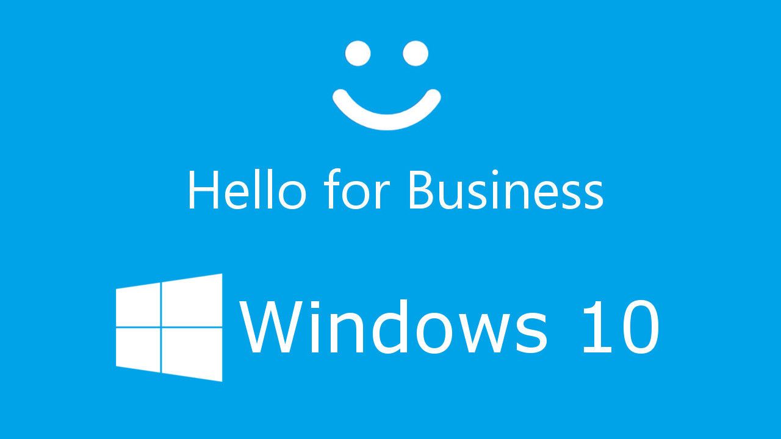

Passwordless Authentication
Windows Hello for Business
Advantages
Uses a PKI for certificate pairs instead of passwords
Uses PIN + Biometrics
Disadvantages
Windows 10 ONLY.
Biometrics are local to the device.

Slide 15
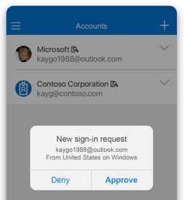
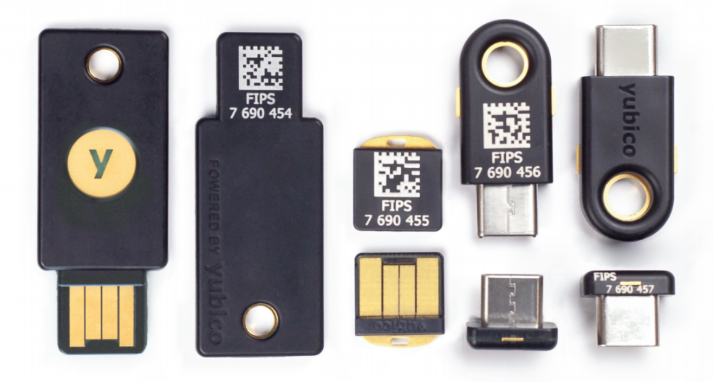
Passwordless Authentication
Microsoft Passwordless authentication using the authenticator app
Enable it at the org level, then allow the users to enable it at the app level
When you hit you organisations page, if Conditional Access allows it, you type your username and it ONLY uses the MS Auth App to authenticate you.
FIDO2 – Fast IDentity Online
Created by a group of vendors, including Microsoft and Google
Revolutionary – flips authentication on it’s head
Traditional: Org gives you a set of credentials to use
FIDO2: You give the org YOUR public certificate to identify you
Your private certificate is on your physical token
certificate signed authentication response – Unique, EVERY TIME.
https://www.acora.com/2020/01/20/raiders-of-the-lost-password/
https://www.microsoft.com/en-gb/security/business/identity/passwordless
Notes:
Advantage – work with everything
Disadvantages
MS App, you have to have the app, operational
FIDO2 – physical keys cost money. (pennys?? NO…)

Slide 16
B2B and B2C

Slide 17
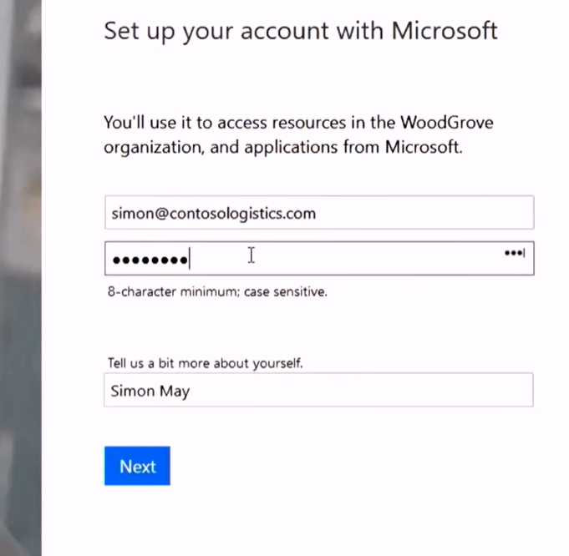
B2B – Business to Business
Sharing your resources with partners – not just SharePoint Documents and meetings, but applications and even external resources
Separates Identity in your organisation from the authentication
Personal accounts like Gmail
Business managed accounts (e.g. “@Contoso.com”)
Don’t need to be 365 accounts!
Can still use Single Sign-on with their business accounts
Protect using Conditional Access and other policies
Paid for features (e.g. AD P1 for MFA) – 1:5 user ratio
Can still use the same security auditing
https://docs.microsoft.com/en-us/azure/active-directory/b2b/what-is-b2b

Slide 18
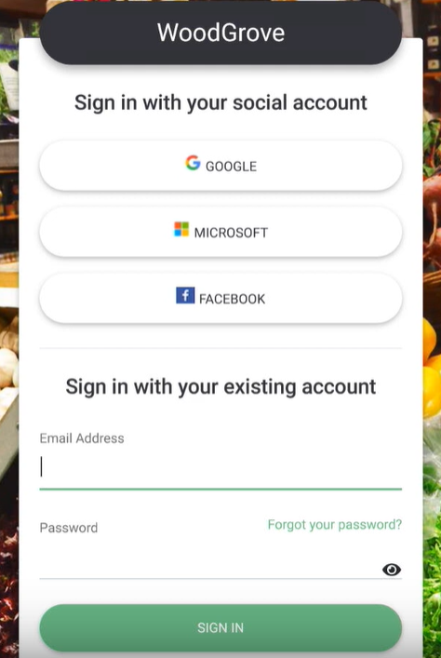

B2C – Business to Consumer
Intended to be used by businesses as a standalone authentication service for securing their services, for example a mobile application or government resource
Customise/brand the interface to make it look like part of the application and allow consumers to use external authentication
Pricing on “Monthly Active Users” and on MFA events
Uses OpenID Connect – allows SAML, OAuth1+2, WS-Fed etc
Identities are managed in the application directory, NOT your AzureAD
https://docs.microsoft.com/en-us/azure/active-directory-b2c/
Notes:
First 50,000 for

Slide 19
Time for a Break
Refuel and Refresh!
We’ll start again in 15 mins…
Part 2 agenda…
Azure AD Single Sign-On Options
Using Azure AD To Secure Your Identities Further (MFA, Identity Protection, Conditional Access)
Azure AD Competitors Comparison

Slide 20
Before we continue…
Answering questions from part 1 …
?

Slide 21
Azure AD Single Sign-On Options

Slide 22
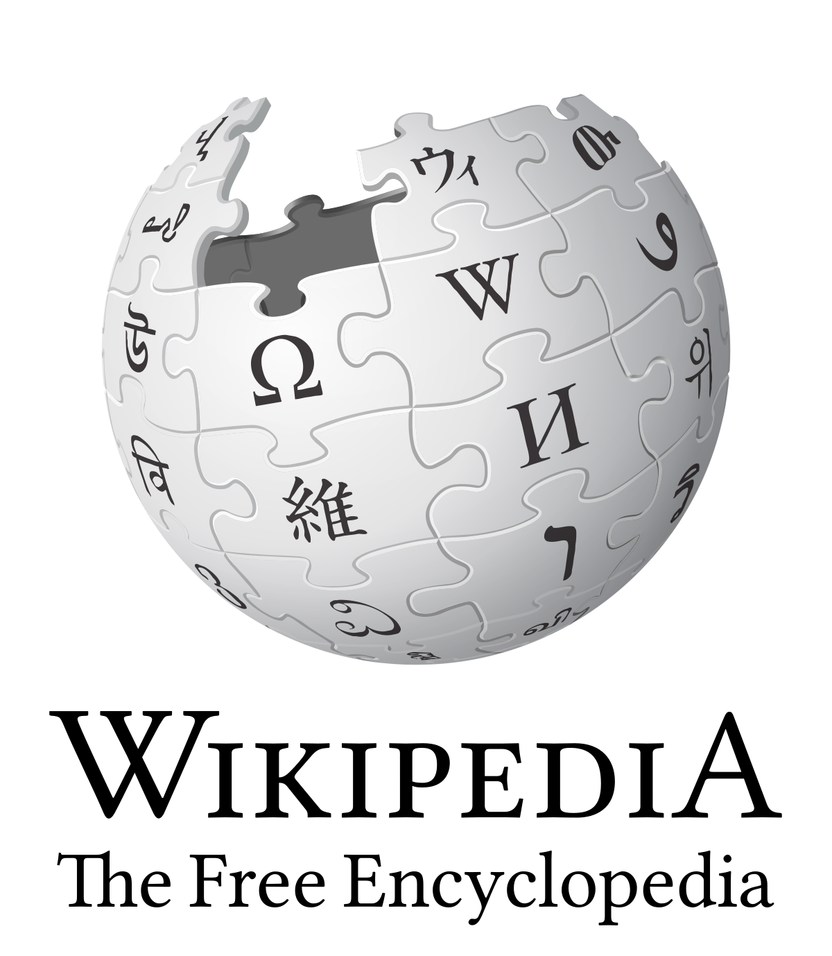
What is Single Sign-on?
For clarity, a distinction should be made between Directory Server Authentication and single sign-on:
Directory Server Authentication refers to systems requiring authentication for each application but using the same credentials from a directory server
Single sign-on refers to systems where a single authentication provides access to multiple applications by passing the authentication token seamlessly to configured applications.
My take on this:
The key in our world is that users should not need to enter their credentials unnecessarily. This is what we term “Frictionless Security”.

Slide 23
Single Sign-On Options (Application management)
Single sign-on method | Application types | When to use
OpenID Connect and OAuth | cloud only | Use OpenID Connect and OAuth when developing a new application. This protocol simplifies application configuration, has easy-to-use SDKs, and enables your application to use MS Graph.
SAML | cloud and on-premises | Choose SAML whenever possible for existing applications that do not use OpenID Connect or OAuth. SAML works for applications that authenticate using one of the SAML protocols.
Password-based | cloud and on-premises | Choose password-based when the application authenticates with username and password. Password-based single sign-on enables secure application password storage and replay using a web browser extension or mobile app. This method uses the existing sign-in process provided by the application, but enables an administrator to manage the passwords.
Linked | cloud and on-premises | Choose linked sign-on when the application is configured for single sign-on in another identity provider service. This option doesn't add single sign-on to the application. However, the application might already have single sign-on implemented using another service such as Active Directory Federation Services.
Disabled | cloud and on-premises | Choose disabled single sign-on when the app isn't ready to be configured for single sign-on. This mode is the default when you create the app.
Integrated Windows Authentication (IWA) | on-premises only | Choose IWA single sign-on for applications that use Integrated Windows Authentication (IWA), or claims-aware applications. For IWA, the Application Proxy connectors use Kerberos Constrained Delegation (KCD) to authenticate users to the application.
Header-based | on-premises only | Use header-based single sign-on when the application uses headers for authentication. Header-based single sign-on requires PingAccess for Azure AD. Application Proxy uses Azure AD to authenticate the user and then passes traffic through the connector service.
OpenID Connect and Oauth is the preferred.
https://docs.microsoft.com/en-us/azure/active-directory/manage-apps/what-is-single-sign-on

Slide 24

Office 365 - Hybrid Identity Example
In a hybrid scenario, Office365 uses a combination of ADConnect to synchronise the identities and credentials, and SAML method to authenticate against the on-premise Directory Service

Slide 25
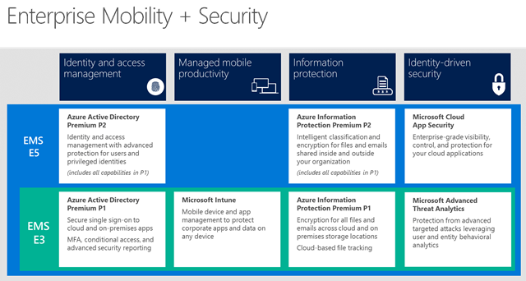
Azure AD Security

Slide 26
The need for security
Alex Weinert, Leads Microsoft's Identity Security and Protection team in 2018:
Each day, our machine learning and heuristic systems provide risk scores for 18 billion login attempts for over 800 million distinct accounts, 300 million of which are discernibly done by adversaries (entities like: criminal actors, hackers).
Breach replay: 4.6BN attacks detected in May 2018
Password spray: 350k in April 2018
Phishing: This is hard to quantify exactly, but we saw 23M risk events in March 2018, many of which are phish related
Notes:
If we accept that Identity is the new control plane – it is critical that we work to protect that new control plane, as it protect our resources.

Slide 27
Azure AD Premium P1 & P2
Typically included as part of EMS E3 and EMS E5, but can be subscribed to separately
 | FREE | OFFICE 365 APPS | PREMIUM P1 | PREMIUM P2
Single sign-on (SSO) | up to ten apps | up to ten apps | unlimited | unlimited
Self-service password with on-premises write-back | r | r | a | a
Microsoft Cloud App Discovery | r | r | a | a
Advanced security and usage reports | r | r | a | a
Dynamic groups | r | r | a | a
Conditional Access | r | r | a | a
Identity protection | r | r | r | a
Identity Governance | r | r | r | a

Slide 28
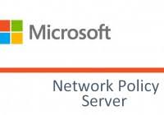
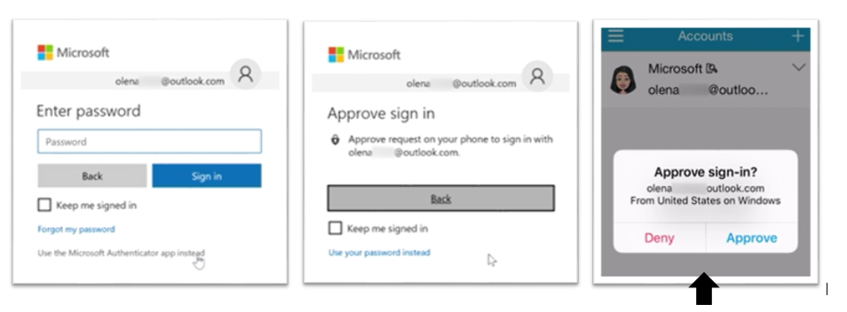
Integrates with:
Multi-Factor Authentication
Can use Azure MFA, or 3rd party provider 2-factor
Azure MFA Included as part of both AD Premium P1 and P2
Provides a 2nd factor of authentication via Text, Phone Call or Authenticator App
As with any 2nd factor in Azure AD, can be called using Conditional Access
Authenticator App
Leverage local biometrics
Integrates with Apple Watch
“Passwordless” Auth
Can be used with any ID authority

Slide 29

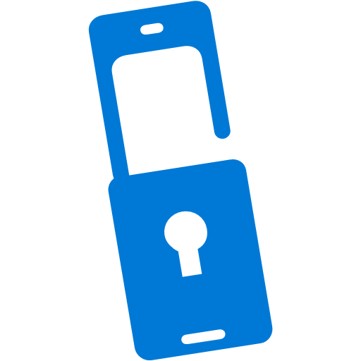
“Conditional Access is at the heart of the new identity driven control plane.”
Conditional Access
Conditions
Controls
10TB
Allow access
Users
Session Risk
Machine learning
3
Devices
Require MFA
On-premises apps
Force password reset
Real time Evaluation
Engine
******
Location
Deny access
Policies
Effective policy
Web apps
Apps
Limit access

Slide 30
Azure Identity Protection
Automate the detection and remediation of identity-based risks.
Investigate risks using data in the portal.
Export risk detection data to third-party utilities for further analysis.
Uses the learnings from Azure AD, the consumer space with Microsoft Accounts, and in gaming with Xbox.
“Microsoft analyses 6.5 trillion signals per day to identify and protect customers from threats.”
Signals are then fed into Conditional Access to make access decisions
Can be fed back to a security information and event management (SIEM) tool for further investigation.

Slide 31
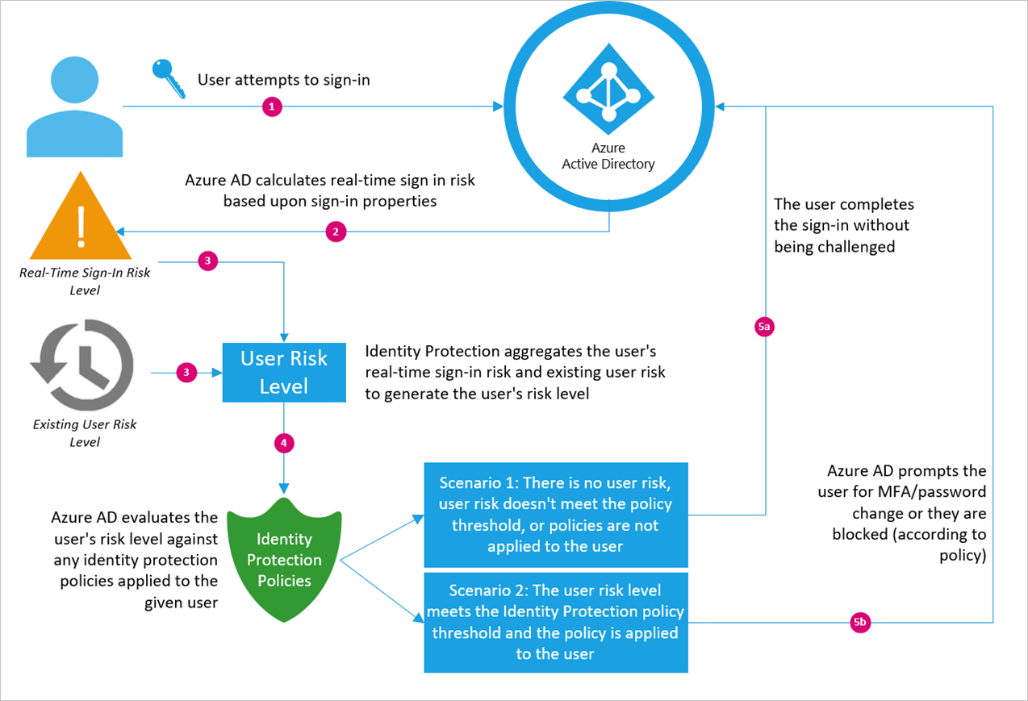
Azure Identity Protection Baseline Flow
This is not part of standard conditional access policies, this is a risk-based analysis of each sign-in powered by Machine Learning, and is part of AD Premium P2.

Slide 32
Competitor Comparison

Slide 33
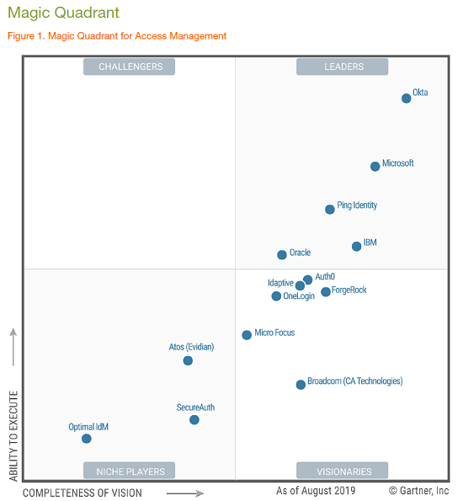
Other Identity Solutions
Okta (founded 2009)
Awesome mobile application, effectively a workspace that users use as their launchpad for everything.
VERY good for acquisition integration, although only from an authentication perspective, not collaboration.
Ping Identity (founded 2000)
I’ve never seen or implemented this in the wild

Slide 34
Before we sign off…
Answering questions from part 2 …
?

Slide 35

Thank you for your time
We will make the deck available for download, and the live event will remain available to watch again.
David Murphy
dmurphy@acora.com

